Slide 1
Credit Risk Prediction

Slide 2
Implement machine learning algorithm in order to predict the credit risk
Abstract:
The primary aim of implementing machine learning algorithms for credit risk prediction.
The analysis seeks to leverage machine learning techniques to enhance the accuracy and effectiveness of credit risk assessment, enabling better-informed decision-making in the financial sector and ultimately contributing to the mitigation of potential credit defaults.

Slide 3
Objective
The overarching objective of this comprehensive analysis is to harness the capabilities of machine learning algorithms to effectively and accurately predict credit risk.
Through the utilization of advanced data analytics techniques and predictive modelling, we aim to develop a robust and precise system that can assess the creditworthiness of individuals, businesses, or entities.
By leveraging historical data, relevant financial indicators, and other pertinent information, our endeavour seeks to enhance the decision-making process in the financial sector, ultimately aiding in the identification and mitigation of potential credit defaults, thereby promoting prudent lending practices and safeguarding financial stability.

Slide 4
Challenges
Many outliers in Savings and

Slide 5
Real World Impact
By harnessing the power of these advanced technologies, financial institutions can make more informed and precise lending decisions, reducing the likelihood of granting credit to high-risk borrowers and thus minimizing the potential for financial losses.
This not only safeguards the stability of these institutions but also promotes responsible lending practices, thereby protecting borrowers from excessive debt burdens and fostering a healthier financial ecosystem.
Furthermore, enhanced credit risk prediction can expand access to credit for deserving individuals and businesses, stimulating economic growth and financial inclusion.
Overall, the implementation of machine learning algorithms in credit risk assessment has the potential to significantly mitigate financial risks, promote economic stability, and improve financial well-being for both lenders and borrowers in the real world.

Slide 6
Dataset
german_credit_data.csv :
The data set has historical data on default status of
1000 customers

Slide 7
Metric selection and Reasoning
Precision and Recall: Precision measures the proportion of true positive predictions out of all positive predictions, while recall measures the proportion of true positive predictions out of all actual positive cases. These metrics are particularly important if the business wants to balance the need to minimize false positives (approving bad loans) and false negatives (rejecting good loans).
F1 Score: The F1 score is the harmonic mean of precision and recall and provides a balanced measure of a model's performance. It can be useful when there is an uneven distribution between positive and negative cases in the dataset.
ROC Curve and AUC: Receiver Operating Characteristic (ROC) curve and Area Under the Curve (AUC) measure the model's ability to discriminate between good and bad credit risks across different decision thresholds. A high AUC indicates good model performance.

Slide 8
Solution Approach and Problem Type
There are multiple ways in which these are handled to name a few are :
Logical Regression
KNN (K Neighbors Classifier)
Random Forest Classifier
XGboost Classifier
SVC (Support Vector Classifier)
Decision Tree Classifier
Naïve Bayes

Slide 9
Libraries
import numpy as np
import pandas as pd
import matplotlib.pyplot as plt
import seaborn as sns
import missingno as msno
Description of these libraries are as follows:-
Pandas for Dataframe operations
Numpy for Numeric operations
Matplotlib, Seaborn and missingno are Data Visualisation libraries

Slide 10
Finding NA and Null values
We found that there are 183 null values in Savings Account.

Slide 11
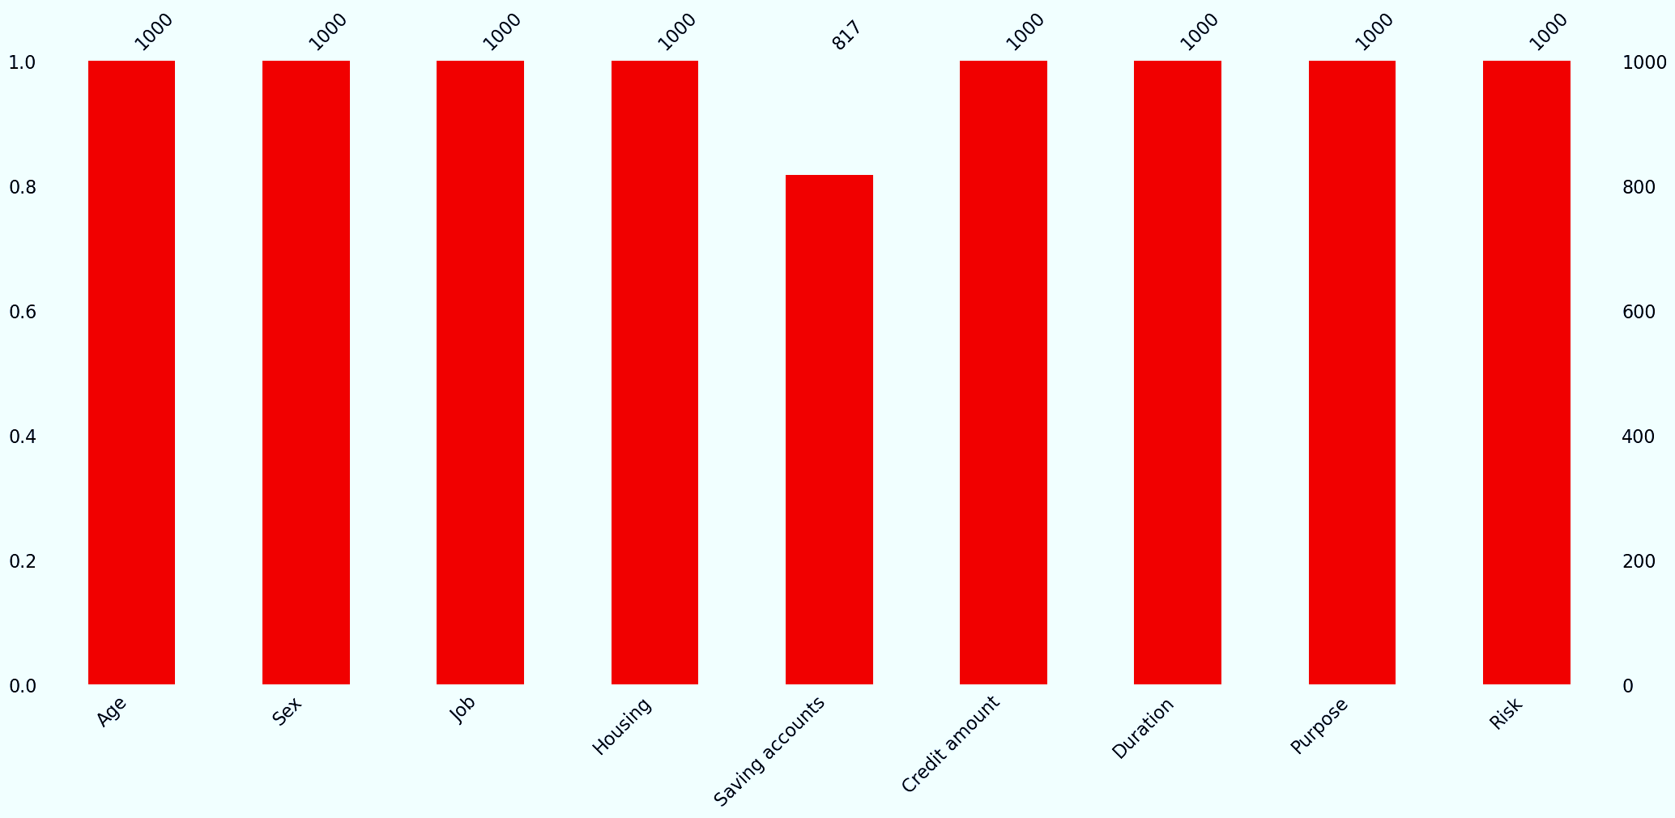

Slide 12
So we replace null values with mean.
Code Snippet:
median = df['Saving accounts'].median()
# Replace null values with the median
df['Saving accounts'].fillna(median, inplace=True)

Slide 13
Unique values
Analysing unique values : -
Saving accounts: 4 values
Housing: 3 values
Purpose: 8 vaues
Risk: 2 values

Slide 14
Replacing Outliers with mean
def replace_outliers_with_mean(df, *var):
for i in var:
q1, q3 = np.percentile(df[i], (25, 75))
IQR = q3 - q1
up_ws = q3 + 1.5 * IQR
lw_ws = q1 - 1.5 * IQR
# Replace outliers with mean value
df.loc[df[i] > up_ws, i] = df[i].mean()
df.loc[df[i] < lw_ws, i] = df[i].mean()
return df
replace_outliers_with_mean(df,'Age','Credit amount', 'Duration')

Slide 15
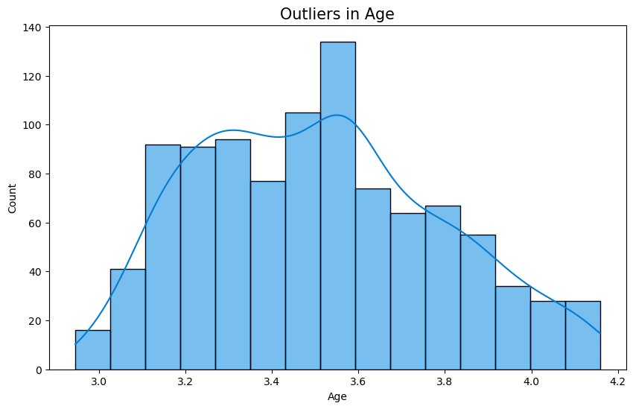

Slide 16
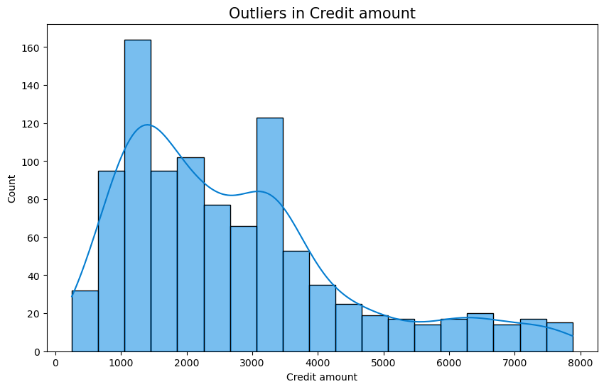

Slide 17
Visualisation

Slide 18
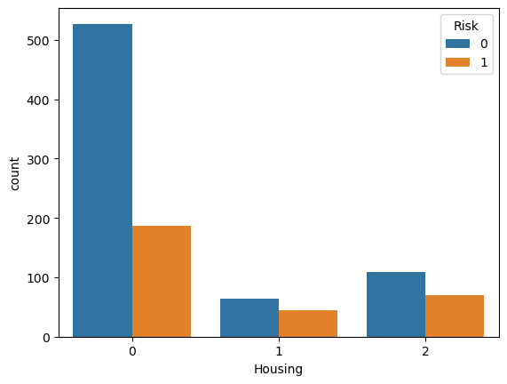
Visualising item Housing with risk (where 0-own, 1-rent, or 2-free)
People who own their own home are more likely to have a 'good' credit rating compared to people who rent.

Slide 19
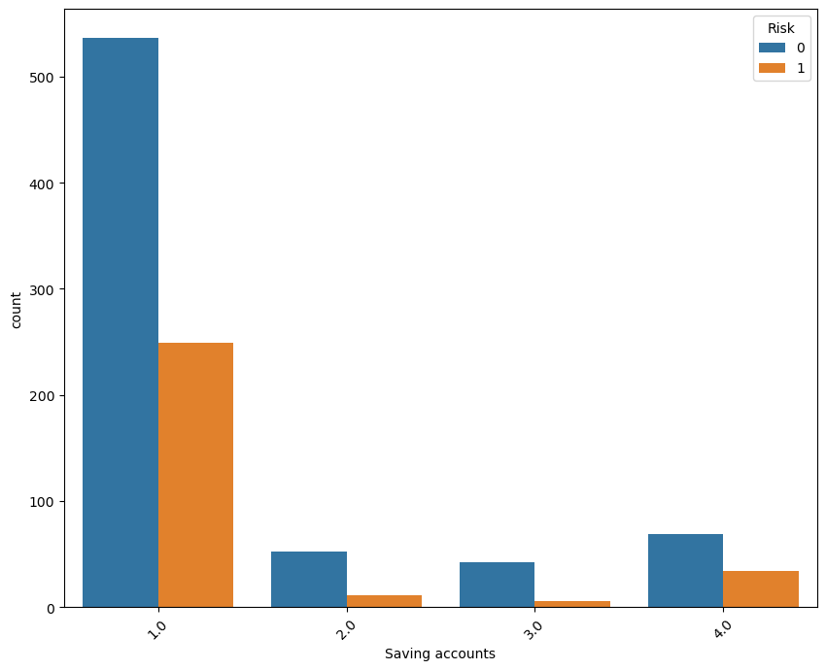
Visualising item Savings account with risk (Where :- [ 1.0- little, 2.0- Quit rich, 3.0- Rich, 4.0- Moderate]) :-
The trend holds. The richer you are, the more likely you are to be classified as good. However, unlike checking accounts, where those with 'little' money have equal distribution of good and bad ratings, in savings accounts, there are visibly more good ratings than bad ones. This makes sense since the very existence of a savings account implies some degree of financial security.

Slide 20
Modeling

Slide 21
Splitting the dataset in to train and test
Module used:
from sklearn.model_selection import train_test_split
Code snippet:
X = df.drop(['Risk', 'Credit amount'], axis=1).values
y = df['Risk'].values
# train-test split
X_train, X_test, y_train, y_test = train_test_split(X, y, test_size = 0.20, random_state=42)

Slide 22
Models used to predict :
1.LogisticRegression
2.KNeighborsClassifier
3.DecisionTreeClassifier
4.RandomForest Classifier
5.Support Vector Classification (SVC)
6.Naive Bayes
7.xgboost

Slide 23
from sklearn.linear_model import LogisticRegression
from sklearn.neighbors import KNeighborsClassifier
from sklearn.tree import DecisionTreeRegressor
from sklearn.tree import DecisionTreeClassifier
from sklearn.ensemble import RandomForestClassifier
from sklearn.metrics import accuracy_score,f1_score
from sklearn.svm import SVC
from sklearn.naive_bayes import GaussianNB
from sklearn.metrics import accuracy_score, confusion_matrix, classification_report, fbeta_score
import xgboost as xgb
Libraries
for
Modeling

Slide 24
Creating models
models=[0]*7
models[0] = LogisticRegression()
models[1] = KNeighborsClassifier()
models[2] = DecisionTreeClassifier()
models[3] = RandomForestClassifier()
models[4] = SVC()
models[5] = GaussianNB()
models[6] = xgb.XGBClassifier()

Slide 25
def check():
for m in models:
model=m
model.fit(X_train,y_train)
y_pred = model.predict(X_test)
print('Model Name: ',m)
print("Accuracy score is: ",accuracy_score(y_test,y_pred)*100)
print(confusion_matrix(y_test, y_pred))
print(classification_report(y_test, y_pred))
print()
check()

Slide 26
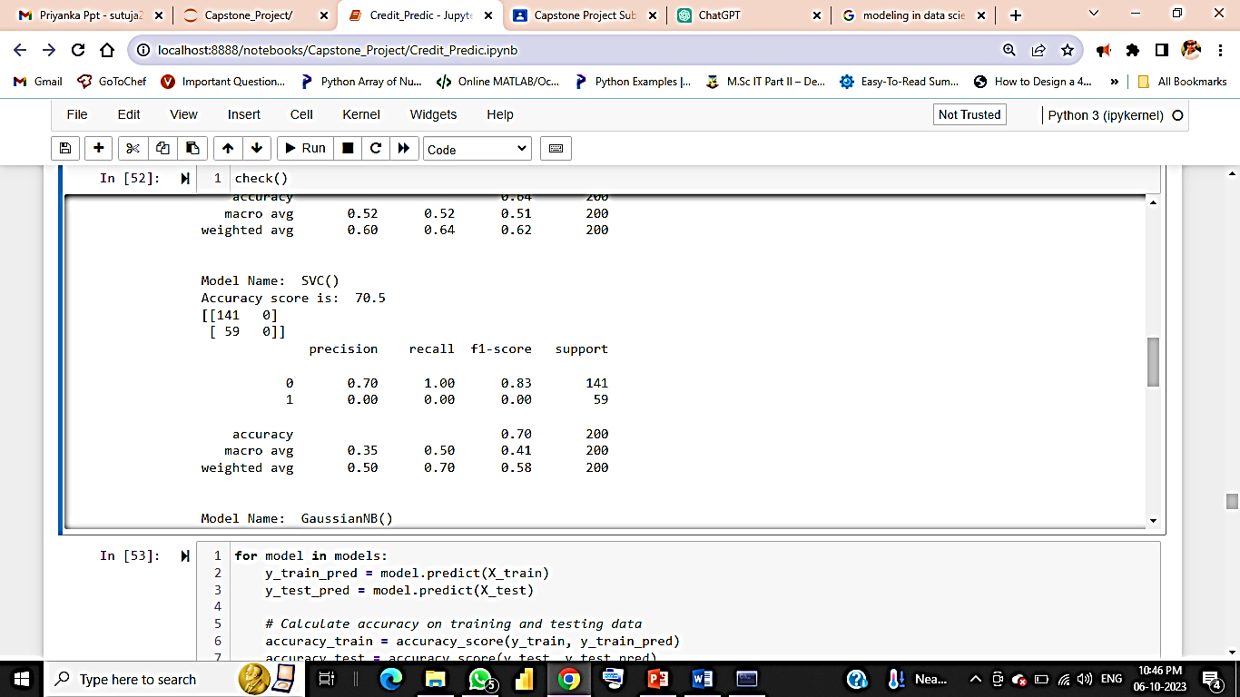
So we get the highest accuracy score in SVc and Logistic regression
Model Name: LogisticRegression()
Accuracy score is: 70.0
[[134 7]
[ 53 6]]
precision recall f1-score support
0 0.72 0.95 0.82 141
1 0.46 0.10 0.17 59
accuracy 0.70 200
macro avg 0.59 0.53 0.49 200
weighted avg 0.64 0.70 0.63 200

Slide 27
After hyperparameter tuning we get
Logistic Regression:
Best Hyperparameters: {'C': 0.1, 'penalty': 'l2', 'solver': 'liblinear'}
Best Model Accuracy: 0.7
SVC:
Best Hyperparameters: {'C': 0.1, 'gamma': 'scale', 'kernel': 'linear'}
Accuracy: 0.705
Naïve Bayes:
Best Hyperparameters: {'var_smoothing': 0.12328467394420659} Accuracy: 0.7
Xgboost:
Best Hyperparameters: {'colsample_bytree': 0.7, 'learning_rate': 0.01, 'max_depth': 5, 'n_estimators': 200, 'subsample': 0.8} Accuracy: 0.705

Slide 28
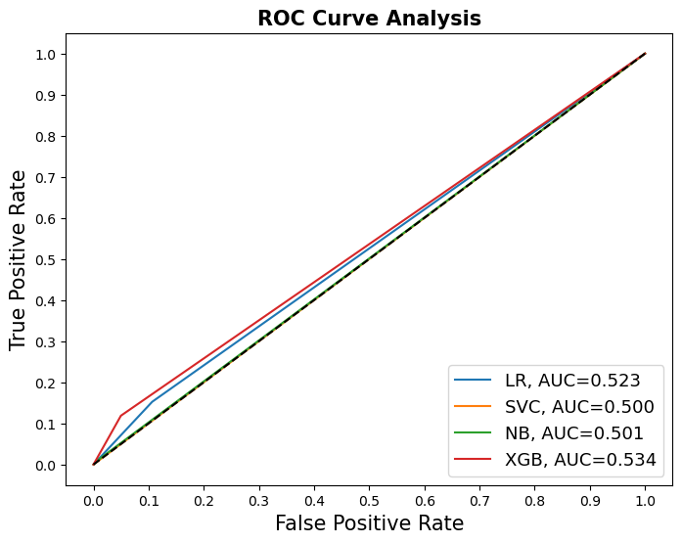

Slide 29
According to our evaluation metric, we can see that the SVC and naïve bayes works the best as it gives us the highest recall. However, when we plot the ROC curves and calculate the AUC for all our models, we can see that SVC and XGB give us the highest AUCs.
Surprisingly, our stacked model does not perform very well. In fact, it has the lowest recall compared to all the base models.
To be short, as our primary aim is to identify bad loans to the best of our abilities, we should stick with the SVC Classifier.

